Slide 1
General announcements

Slide 2
Gravitational PE
Near the Earth’s surface, the gravitational potential energy of any object of mass m at a height y above a reference point can be found by:
You get to decide where y = 0 is!
Depending on the problem, it might be the ground, a table, the lowest point the object reaches, the highest point, whatever.
It doesn’t matter where y = 0 is as long as you indicate where it is, and you keep it consistent. It’s the change of position that’s important.
Gravitational PE is also measured in Joules, just like kinetic energy and work.
Gravitational PE can turn into kinetic energy and vice versa without being “lost” – as long as there are no outside forces doing work. This is part of being a conservative force.
$$U=mgy$$

Slide 3
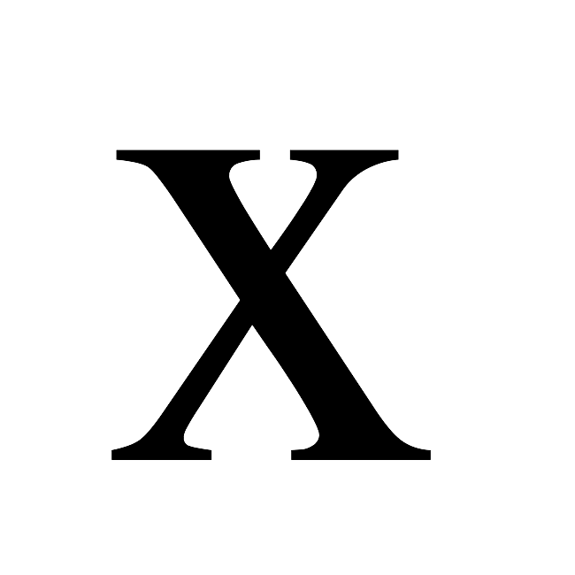
Springs!
Attach a mass to a spring and push or pull it. It will displace a distance x from its equilibrium position, depending on the amount of force you apply.
If you let go, the spring bounces back. This means the amount you pull is equal to what’s called the restoring force, which (surprise, surprise) restores the spring to equilibrium. The force the spring applied to the block will be:

Slide 4
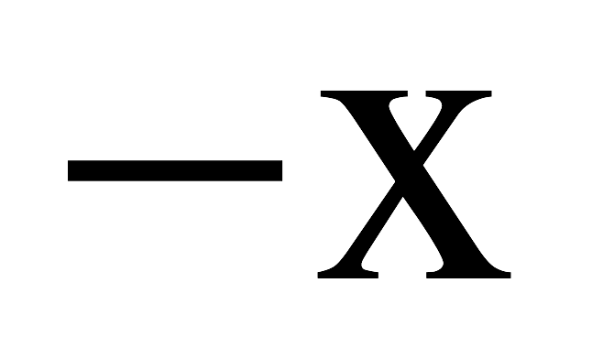
Springs!
In F_{spring} = -kx, what does the “k” stand for and what does it tell you?
What does the negative sign do in the expression? Does your explanation make sense for the second set-up shown below?
k is called the spring constant, and is unique to a given spring. A bigger k means a stiffer spring; a smaller k means a looser spring. Its units are N/m.
The negative sign indicates that the restoring force applied by the spring is opposite the direction of displacement from equilibrium.
If the mass in the first sketch was held in that position, would it have energy as a consequence of its contact with the spring? If so, how much?

Slide 5
Spring potential energy
An ideal spring (a spring that doesn’t lose energy to friction as it oscillates back and forth) generates a conservative forces when it acts on a mass. That means the spring can be assigned a potential energy function.
The whole idea behind a potential energy function is to find a function that, when evaluated at two points in the function’s force field, will have a difference equal to the work done by the field as a body moves between those two points. We did this for gravity by comparing the solution of “mg” dotted into “d” to
The problem with a spring is that spring forces are not constant (the more you pull a spring, the more force it applies back on you) as was the case with gravity near the earth’s surface. That means we need to use Calculus to get the job done.

Slide 6
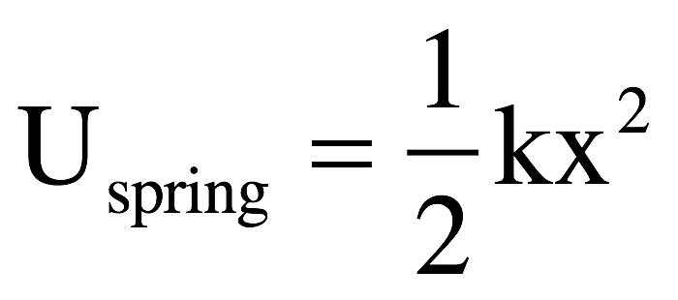
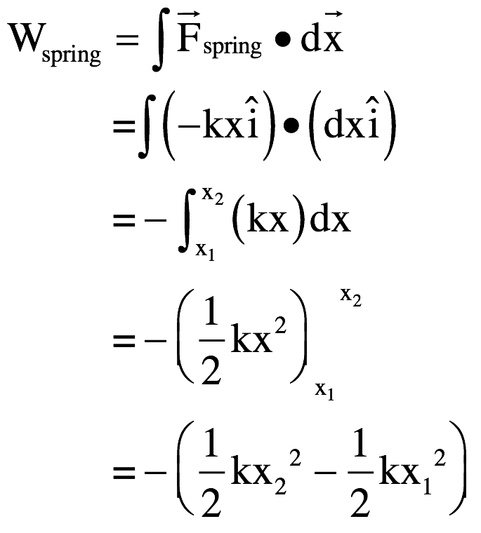
Spring potential energy
The approach is simple. We determine how much work is involved in moving the spring a differential (read this “very small”) displacement “dx,” then sum up all such values between our start and finish position. So let’s assume the spring starts at distance x₁ from its equilibrium position, and moves to distance x₂ (note that it doesn’t matter which of these is larger). Using an integral sign to do the summation, this reads:
Since , this suggests that:

Slide 7
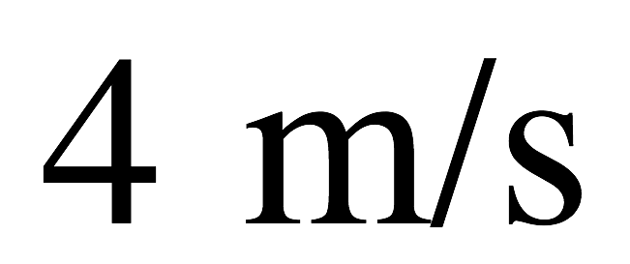
Spring energy example
What you are seeing below is a snapshot of a 600 gram mass attached to a spring whose spring constant “k” is 2.0 N/m. At t=0 seconds, the mass is moving to the left at x = -1.4 meters with a speed of 4 m/s.
What is total mechanical energy of the system?
Determine mass’s speed when x = -0.2 m
Determine maximum distance from equilibrium
At what point will its kinetic and potential energy be equal?

Slide 8
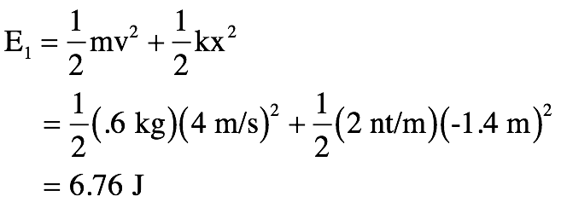
a.) What is the total mechanical energy in the system?
b.) Determine the mass’s speed when at x = -0.2 meters.
If we know the total energy in the system, we can use that information and the total energy expression to determine the velocity at x = -0.2 meters.

Slide 9
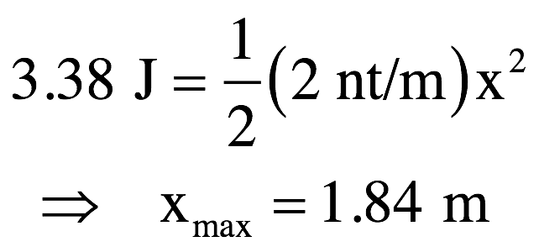
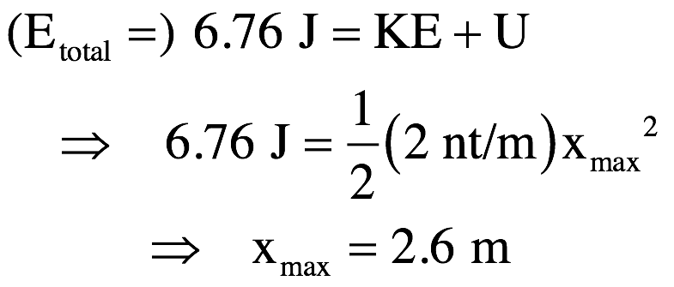
c.) Determine its maximum deflection (distance from x = 0).
At maximum deflection, the body isn’t moving so the kinetic energy is zero, and all the energy in the system is potential. Sooo . . .
d.) At what coordinate will its potential and kinetic energy be equal?
This will occur when half the 6.76 joules is wrapped up in potential energy, or:

Slide 10
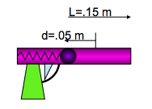
Toy gun launch
A 5.3 gram ball is projected by a spring in a gun. The spring’s spring constant is 8.0 N/m. If the gun barrel is 15 cm and a constant frictional force of .032 N exists between the ball and the barrel, what is the ball’s speed when it leaves the barrel. Assume the spring was compressed 5.0 cm for the launch?

Slide 11
Using conservation of energy on the ball, we get:

